Slide 1
MOTOR VEHICLE EMISSIONS
Department of Mechanical Engineering, Pulchowk Campus
Institute of Engineering

Slide 2
AUTOMOTIVE POLLUTION
LOCAL
  Direct Toxins:
    CO, Nitric Oxide, Ozone, Benzene, Toluene, etc.
REGIONAL
  Atmospheric Formation:
    Smog, Haze, Ozone, Nitric Acid
GLOBAL
  Ozone Layer Depletion, Global Warming, Global Cooling,
    CO_{2,}, CH₄, Sulphates, CFC’s
DME
Pulchowk Campus, IOE
Notes:
Automobiles produce pollution. Their predecessors (horses) also produced pollution and clearing the cities of dung and straw was a major problem. The switch to cars and trucks solved that large solids waste problem but created an airborne waste problem that is now growing as the number of cars and distance travelled continues to grow worldwide.
Car pollution problems exist on three scales: Local, Regional and Global.
Local pollution is simply the direct exposure to evaporated fuel and tailpipe pollution which has direct toxic effects on people. CO is poisonous, Ozone and NO damage lungs, benzene is carcinogenic ...
Regional pollution is the result of many cars operating in a region (such as a large city) and their overall pollution level building up enough that air chemistry reactions between those pollutants produce new pollutants. This first became apparent in Los Angeles in the 1940’s due to very (un)favorable weather conditions. It is now apparent that it occurs in almost any climate once enough NO and HC is released over a wide area. It is the unique combination of NO and HC which forms smog and which characterizes automotive exhaust. ... discussion of smog...
Global pollution is mostly concerned with global warming (CO2 and other greenhouse gases) and ozone layer depletion (chlorine compounds & NOx).
To reduce global warming, you mostly want to make processes more efficient and use less C in your fuel. (eg; nuclear rather than coal).

Slide 3
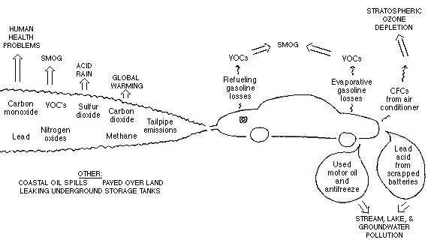
SOURCES OF VEHICLE EMISSION
DME
Pulchowk Campus, IOE

Slide 4
Pollutant formation
Pollutants | Formation mechanism
CO | Incomplete combustion (rich mixture) – O₂ deficit
HC | Incomplete combustion (rich mixture)- O₂ deficit Source: crevices, oil layers, deposits, liquid fuels, flame quenching, exhaust valve leakage
NOx | At high temp N₂ reacts with O to from NO. NOx is max with mixtures slightly lean of stoichiometric.
PM | Solid carbon material (soot) due to deficit of oxygen
SOx | Presence of sulfur in the fuel
DME
Pulchowk Campus, IOE

Slide 5

EVAPORATIVE & REFUELING EMISSIONS
Diurnal (breathing) losses.
Running losses.
Hot soak.
Refueling.
DME
Pulchowk Campus, IOE

Slide 6
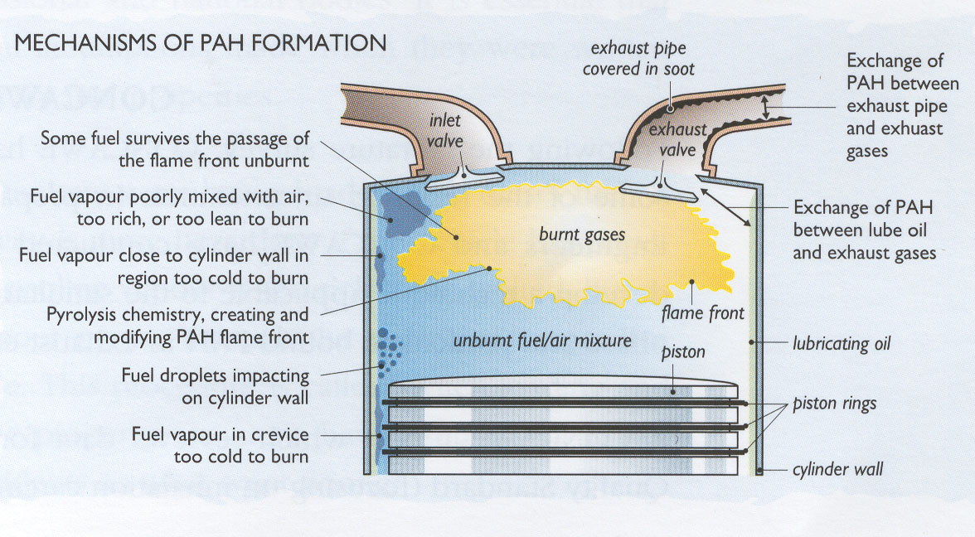
MECHANISM OF POLYAROMATIC HYDROCARBONS
DME
Pulchowk Campus, IOE

Slide 7
HEALTH IMPACTS OF COMMON POLLUTANTS
Carbon monoxide (CO) affects especially persons with heart disease, and fetuses.
Unburned hydrocarbon (HC) has serious health effect on people who suffer from lung diseases, asthma or emphysema.
Nitrogen oxides (NOx) is linked to a wide range of respiratory problems; cough, runny nose, and sore throat are among the most common.
Ozone can cause chest pain, coughing, and shortness of breath. When inhaled, ozone can cause temporary decreases in lung function of 15 to over 20% in healthy adults.
Lead exposure will lead to a decrease in intelligence quotient and can, in some cases, also lead to premature deaths.
Particulate matter (PM) is associated with premature death, aggravation of respiratory and cardiovascular disease, and decrease in lung function.
DME
Pulchowk Campus, IOE

Slide 8
INTERNAL COMBUSTION ENGINE
Complete combustion of fuel gives
  Fuel (HC) + Air (oxygen + nitrogen) =>
  Carbon dioxide + water + unaffected nitrogen
Incomplete combustion of fuel gives
  Fuel + Air => Unburned HC + NOx + CO +
  CO₂ + SOx + ….
DME
Pulchowk Campus, IOE

Slide 9
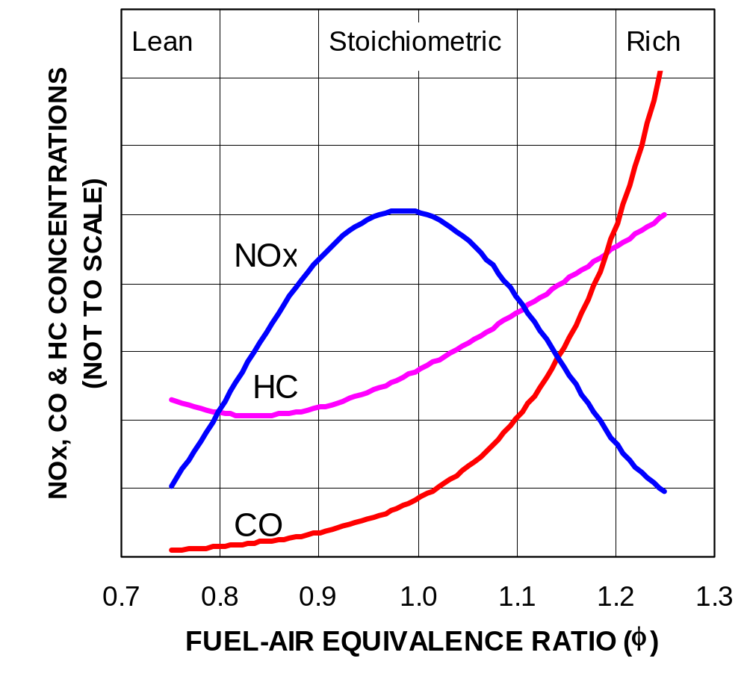
AIR-FUEL RATIO VS EMISSIONS
DME
Pulchowk Campus, IOE

Slide 10
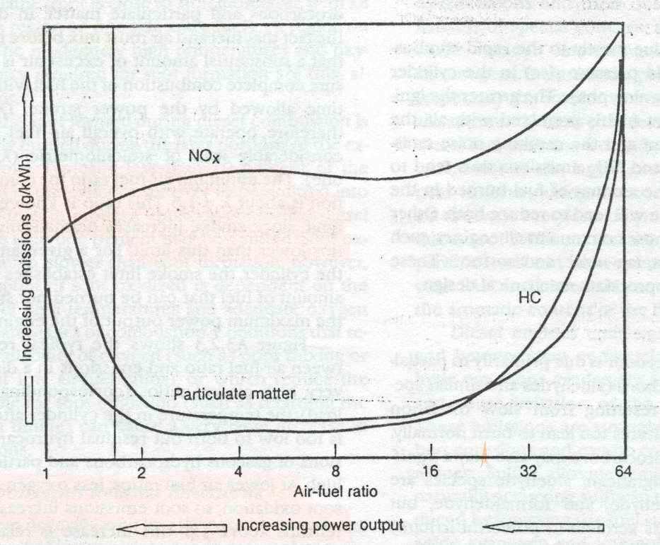
SMOKE LIMIT IN DIESEL ENGINE
DME
Pulchowk Campus, IOE

Slide 11
CAUSES OF MOTOR VEHICLE POLLUTION (continued)
Improper Maintenance
  Low quality parts
  No culture of preventive maintenance
  Lack of formal knowledge, equipment, skills
  No auditing of I&M facilities
Poor transport infrastructure & road conditions
Fraud and Corruption
Driving habits
DME
Pulchowk Campus, IOE

Slide 12
VEHICULAR EMISSION CONTROL STRATEGIES
Appropriate vehicle emission standard for new and in-use vehicles
Set stringent emission standards for registration of new vehicles
Require use of cleaner fuel
Require mandatory periodic inspection of in-use vehicles
Take stringent enforcement actions
Promote education on proper vehicle maintenance to prevent smoke emission
DME
Pulchowk Campus, IOE

Slide 13
ELEMENTS OF A COMPREHENSIVE VEHICLE POLLUTION CONTROL STRATEGY
Emission Standards
(Vehicle Technology)
Inspection &
Maintenance
Transport Planning &
Demand Management
Cleaner Fuels
DME
Pulchowk Campus, IOE
Notes:
Reducing vehicle pollution will usually require a comprehensive strategy. Generally, the goal of a motor vehicle pollution control program is to reduce emissions from in-use motor vehicles to the degree reasonably necessary to achieve healthy air quality as rapidly as possible.
A comprehensive strategy to achieve such goals includes four key components: i) increasingly stringent emission standards for new vehicles, ii) specifications for clean fuels, iii) programs to assure proper maintenance of in-use vehicles, iv) and transportation planning and demand management. These emission reduction goals should be achieved in the most cost-effective manner available.

Slide 14
EMISSION STANDARDS
AND
VEHICLE TECHNOLOGY
DME
Pulchowk Campus, IOE

Slide 15
IDLE TEST EMISSION STANDARD OF NEPAL
Vehicle Type | Model Year | CO, % | HC, ppm
Petrol/LPG vehicles | Up to 1980 After 1981 | 4.5 3.0 | 1000
Three wheeler | Up to 1991 After 1992 | 4.5 3.0 | 7800
Two wheeler |  | 4.5 | 7800
DME
Pulchowk Campus, IOE
Notes:
HSU (Hatridge Smoke Unit) is the percentage opacity measurement for a column of smoke 430mm in length.
Commercial vehicles (taxi, bus, truck) are tested twice a year for emission.
k is the coefficient of light absorption, a measure of ‘blackness’ of the smoke which is independent of the measurement length.

Slide 16
VEHICLE EMISSION-CONTROL TECHNOLOGIES
ENGINE EMISSION CONTROL
  Crank case emission control (blow-by)
  Combustion control (EGR, variable spark timing)
  Exhaust after-treatment (closed loop 3-way catalytic converter, air injection)
EVAPORATIVE EMISION CONTROL (Charcoal canister)
ONBOARD DIAGNOSTIC SYSTEM (OBD)
IMPROVEMENT IN FUEL QUALITY (Cleaner fuel)
DME
Pulchowk Campus, IOE

Slide 17
ENGINE DESIGN
Fuel injection system. Replacement of carburetor by electronic fuel injection system.
Exhaust gas recirculation (EGR). 15-25% of recirculated exhaust gas helps to reduce NOx by lowering the temperature.
Fast burn techniques. A compact shape of combustion chamber is designed in such a way that swirl is created during the induction process and during the latter states of combustion and locating the spark plug at the center.
DME
Pulchowk Campus, IOE

Slide 18
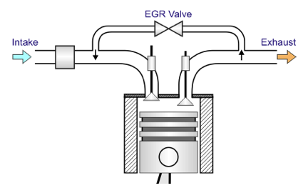
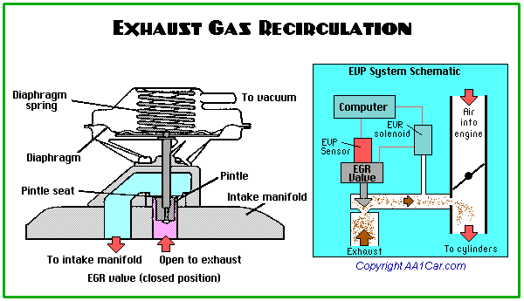
The EGR system reduces NOx production by recirculating small amounts of exhaust gases into the intake manifold where it mixes with the incoming A-F charge. By diluting the A-F mixture under these conditions, peak combustion temperatures and pressures are reduced, resulting in an overall reduction of NOx output.
DME
Pulchowk Campus, IOE

Slide 19
ENGINE DESIGN (continued.)
Ignition system. Transistorized coil and distributorless electronic ignition systems are replacing simple coil and distributor system.
Cold start emission control. Inlet air heating, cylinder block heating.
DME
Pulchowk Campus, IOE

Slide 20
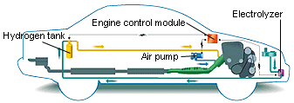
THE HYDROGEN START
DME
Pulchowk Campus, IOE

Slide 21
EXHAUST GAS AFTER TREATMENT
Air injection. The injected air oxidizes the HC & CO of exhaust gases into H₂O & CO₂ at min. temp of 600 & 700ºC respectively.
Catalytic converter. It provides an additional area for oxidation or combustion to occur. It is located in the exhaust system ahead of the muffler. Pt & Pd are used as catalyst, CO & HC are chemically oxidized or converted to CO₂ & H₂O (Figure).
  Catalyst damage:
    Excessive heat generated by burning of oxygen and HC.
    Poisoning (Pb, P).
DME
Pulchowk Campus, IOE

Slide 22
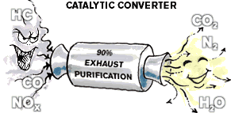
CATALYTIC CONVERTER
Oxidation:
HC + CO + O₂ =>
H₂O + 2CO₂
Reduction:
2NO₂ => N₂ + 2O₂
DME
Pulchowk Campus, IOE

Slide 23
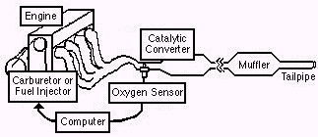
FUEL INJECTION SYSTEM
DME
Pulchowk Campus, IOE

Slide 24

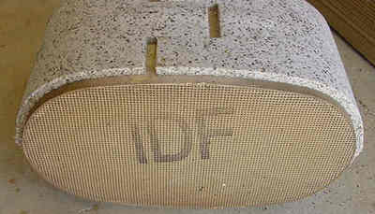
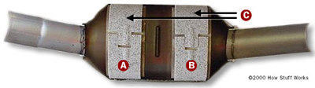

A three-way catalytic converter -- note the two separate catalysts.
DME
Pulchowk Campus, IOE

Slide 25
DESIGN & MODIFICATION IN CI ENGINE
Reducing parasitic HC & PM emissions by minimizing/eliminating nozzle volume.
Reducing emission of PM & NOx by cooling the compressed air charge before it enters the combustion chamber (inter-cooled turbocharged diesel engine).
Reducing NOx in vehicles by recirculating exhaust gas.
Improving air utilization & reducing HC & PM emissions by minimizing parasitic volume in the combustion chamber.
DME
Pulchowk Campus, IOE

Slide 26
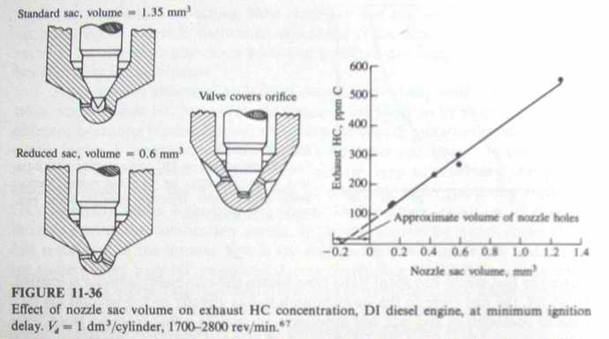
EFFECT OF NOZZLE SAC VOLUME ON HC CONCENTRATIONS
DME
Pulchowk Campus, IOE

Slide 27
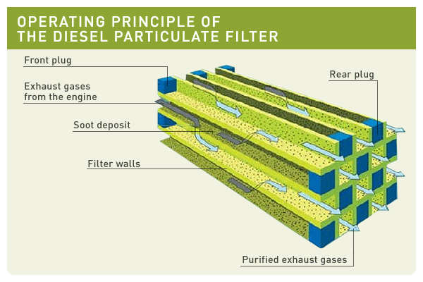
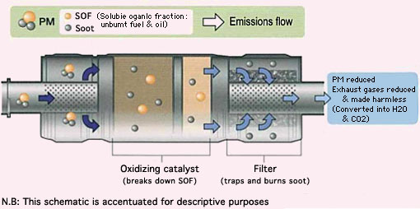
EXHAUST GAS AFTER TREATMENT
Particulate trap controls diesel emissions by physically trapping the particulates, HC etc.(Figure).
Catalytic converters oxidize CO, HC & particulate matters to CO₂ and H₂O and reduce NOx .
DME
Pulchowk Campus, IOE

Slide 28
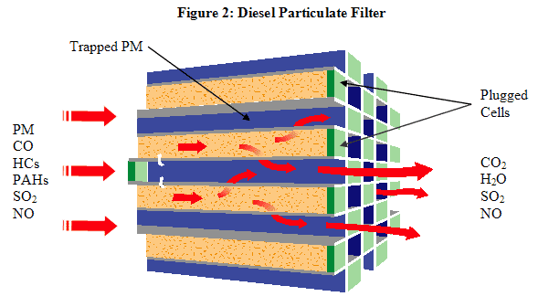
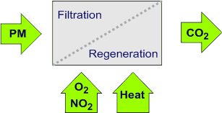
PARTICULATE FILTER
Diesel particulate filters (DPF) are devices that physically capture diesel particulates to prevent their release to the atmosphere.
Diesel particulate filter materials have been developed that show impressive filtration efficiencies, in excess of 90%, as well as good mechanical and thermal durability.
Diesel particulate filters have become the most effective technology for the control of diesel particulate emissions—including particle mass and numbers—with high efficiencies.
DME
Pulchowk Campus, IOE

Slide 29
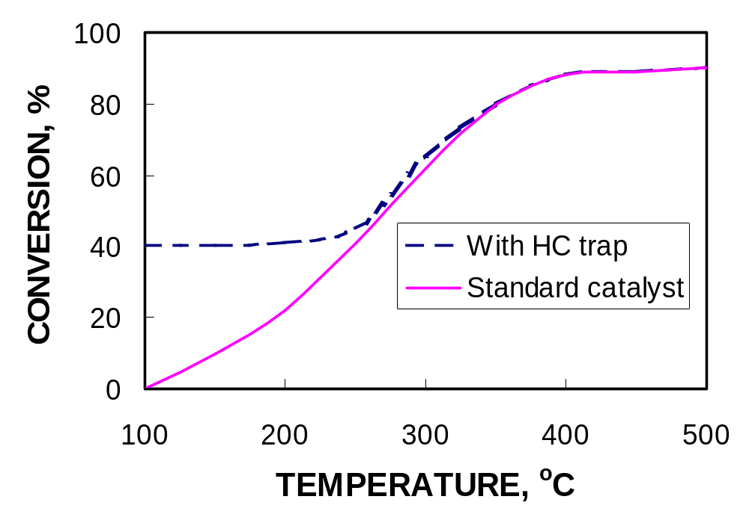
HYDROCARBONS IN CATALYST WITH HC TRAP
DME
Pulchowk Campus, IOE

Slide 30
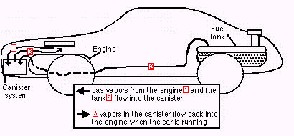
CHARCOAL CANISTER
DME
Pulchowk Campus, IOE

Slide 31
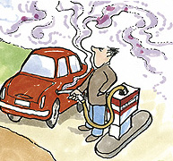
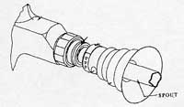
VAPOR RECOVERY NOZZLE
DME
Pulchowk Campus, IOE

Slide 32
CLEANER FUEL
Note: Stringent emission standards are met with the introduction of pollution control devices which demand the use of cleaner fuel.
DME
Pulchowk Campus, IOE

Slide 33
FUEL PARAMETERS AFFECTING POLLUTANT EMISSIONS
Fuel | Parameters | Effects | Permissible Range
Gasoline | Lead Content Volatility Benzene & other Aromatic HCs Density at 15°C | TEL is added to gasoline to increase Octane No. TEL also lubricates the exhaust valve seats of engine. Gasoline with low RVP has lower evaporative & fugitive emissions Aromatic HCs help to raise Octane No. | Unleaded gasoline contains 0.005 g/L Octane No: 86-94 Summer: 7-8 psi Winter: higher India: 35-60 kPa Benzene: 1 – 3% Benzene: 1% (India) 720-775 kg/m³
DME
Pulchowk Campus, IOE

Slide 34
FUEL PARAMETERS AFFECTING POLLUTANT EMISSIONS
Fuel | Parameters | Effects | Permissible Range
Reformulated Gasoline | MTBE + gasoline | Added MTBE in gasoline reduces volatility and sulfur Reduces exhaust emissions like NMHC, CO. But aldehyde emission can be increased. | MTBE: 5-11% by volume
DME
Pulchowk Campus, IOE

Slide 35
FUEL PARAMETERS AFFECTING POLLUTANT EMISSIONS
Fuel | Parameters | Effects | Permissible Range
Oxygenated Gasoline | Alcohol based: Ethanol Methanol Ether based: MTBE ETBE TAME Alcohol based oxygenates have higher evaporative emissions than ether based oxygenates. | Combustion of oxygenated gasoline produces lower CO & HC exhaust emissions than straight gasoline. | Ethanol = 5% in India Varies with refineries.
DME
Pulchowk Campus, IOE

Slide 36
FUEL PARAMETERS AFFECTING POLLUTANT EMISSIONS
Fuel | Advantages | Disadvantages | Properties
Kerosene | Heating value is about 10% higher than gasoline on volume basis Better lubrication of fuel pump because of its relatively higher viscosity Lower volatility – less evaporation and lower tendency for vapor lock | Lower heating value than gasoline on mass basis by 3% Poor starting characteristics Higher viscosity – carries more dirt to the fuel pump | Boiling point: 160°C - 300°C Density: 770-850 kg/m³ Flash point: 35-60°C Sulfur: 0.25% Octane # : 45-50 (not suitable for SI Engine having compression ration >5:1).
Blend of kerosene and gasoline gives an intermediate results
DME
Pulchowk Campus, IOE

Slide 37
FUEL PARAMETERS AFFECTING POLLUTANT EMISSIONS
Fuel | Parameters | Effects | Permissible Range
Diesel | Sulfur Cetane No. Aromatic HCs & Density | Presence of S produces SOx (SO₂+SO₃) & PM in the exhaust. The higher CN, the shorter the delay between injection and ignition and better the ignition quality. A higher CN improves combustion and reduces HC, CO & PM during vehicle warm up, improves cold starting, reduces white smoke after starting, lowers noise levels. At lower CN (<45) black smoke & HC & CO emissions increases. Diesel fuel with a higher aromatic HC content tend to be denser and have lower Cetane no. A high HC makes difficulty in cold engine stating and increase in HC, NOx, PM and noise emissions. Higher density diesel fuels results in black smoke and PM emissions. | Sulfur content, % by weight USA: 0.0015 % EU: 0.0015 % India: 50 mg/kg Cetane NO. EU: 43 – 57 USA: 40 – 44 India: 51 Max Aromatic HC content, % by volume 20 – 30% Density, kg/m³ 820 – 880 820 – 860 (India)
DME
Pulchowk Campus, IOE

Slide 38
FUEL ADULTERATION
Adulteration of automotive gasoline and diesel is widespread throughout South Asia.
Engine performance is altered.
Increase tailpipe emissions of harmful pollutants.
DME
Pulchowk Campus, IOE

Slide 39
CAUSE OF FUEL ADULTERATION
Different taxes for different fuels: gasoline carries much higher tax than diesel and diesel is taxed more than kerosene.
Industrial solvents and recycled lubricants are other material with little or no tax.
DME
Pulchowk Campus, IOE

Slide 40
TYPES OF FUEL ADULTERATION
Blending of relatively small amounts of distillate fuels like diesel or kerosene into automotive gasoline.
Blending variable amounts (as much as 30%) of gasoline boiling range hydrocarbons such as industrial solvents into automotive gasoline.
Blending small amounts of spent waste industrial solvents such as used lubricants – which would be costly to dispose of in an environmentally approved manner – into gasoline and diesel.
Blending kerosene into diesel, often as much as 20-30 percent.
Blending small amounts of heavier fuel oils into diesel fuels.
DME
Pulchowk Campus, IOE

Slide 41
APPROACHES TO THE DESIGN OF
LOW-EMISSION VEHICLES
Alternative fuels: They are alternatives to gasoline and have potential to reduce pollution since they do not contain toxic compounds like benzene, VOCs.
Disadvantages:
Lesser vehicle range
Higher cost ( especially during modification)
More fuel storage size and weight
DME
Pulchowk Campus, IOE

Slide 42
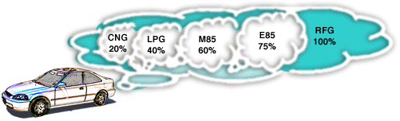
ALTERNATIVE FUELS
Do alternative fuels offer any emissions benefits?
Yes, all of the alternative fuels reduce ozone-forming tailpipe emissions. The diagram above shows the percentage of combined carbon monoxide (CO) and nitrogen oxide NO_{x} emissions for each alternative fuel as compared to reformulated gasoline (RFG). For example, the emissions from CNG vehicles are estimated to be 20%, compared to 100% emissions from vehicles using RFG. CNG vehicles demonstrate an 80% reduction in ozone-forming emissions.
DME
Pulchowk Campus, IOE

Slide 43
LIQUEFIED PETROLEUM GAS
  LPG is a by-product of petroleum refining and natural gas production. It consists mainly of propane stored in liquefied form at a pressure of 5-10 bars.
  Advantages: lower emission of CO & HC, higher octane number (RON=110-120)
  Disadvantages: higher weight of tank, less space for luggage, slightly reduced performance.
DME
Pulchowk Campus, IOE

Slide 44
COMPRESSED NATURAL GAS
  CNG. The pressurized natural gas is known as compressed natural gas. It mainly consists of methane (85-95%) and other hydrocarbons.
  Advantages:
    It is a clean-burning fuel that reduces cost of vehicle maintenance.
    Exhaust emissions from natural gas vehicles are much lower than those of equivalent gasoline powered vehicles: CO – 70%, NOx – 87%, non-methane HC – 89%.
    It is less expensive than gasoline and has higher octane number (RON=130).
  Disadvantage:
    Compression of natural gas in a heavy tank at 200-300 bars.
    The infrastructure of distribution of CNG is also comparatively high.
DME
Pulchowk Campus, IOE

Slide 45
ALCOHOLS
  Alcohols (methanol & ethanol) provide greater power and acceleration and are much less flammable than gasoline.
  Advantages:
    It emits less CO, NOx & VOCs than gasoline.
    It is added to gasoline to increase octane rating.
  Disadvantages:
    Lower energy content (22 – 30 MJ/kg)
    More expensive
    Shorter driving range
    Poor cold start
DME
Pulchowk Campus, IOE

Slide 46
DUEL-FUEL ENGINES
Duel-fuel engine.Natural gas can be burned in diesel engine by mixing it with intake air. The injected diesel fuel in the combustion chamber serves to ignite the natural gas. About 30-40% of total energy is supplied by diesel & rest is being supplied by natural gas.
Advantages: NOx and PM are reduced.
Disadvantages: extra cost for modification, HC & CO are increased which can be reduced by oxidation catalyst.
DME
Pulchowk Campus, IOE

Slide 47
ELECTYRIC VEHICLES
Electric vehicles. The electric vehicles are powered by electricity. Rechargeable lead-acid batteries are commonly used.
Advantages: no tailpipe emissions.
Disadvantages:
  Substantial electrical energy cost
  High initial cost
  Batteries are heavy and occupy a lot of room
  Acceleration is poor
  Infrastructure for recharging batteries along the road side has to be developed.
  Disposal and management of lead acid batteries.
DME
Pulchowk Campus, IOE

Slide 48
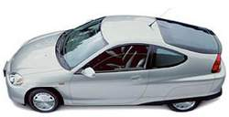
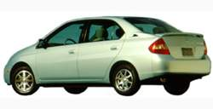
HYBRID VEHICLES
Hybrid vehicles. Any vehicle is hybrid when it combines two or more sources of power. They have battery, electric motor and engine. The engine is used when extra power is needed for accelerating or for driving long distances.
Advantages: very low emissions, greater range and better acceleration.
Honda Insight
Toyota Prius
DME
Pulchowk Campus, IOE

Slide 49
FUEL CELL VEHICLES
Fuel cell vehicles. Fuel cells are electrochemical devices that directly produce DC electricity without combustion. Fuel cell produces electric power as long as they are supplied with hydrogen and oxygen.
Advantage: no vehicle emission
Disadvantage:very expensive.
DME
Pulchowk Campus, IOE

Slide 50
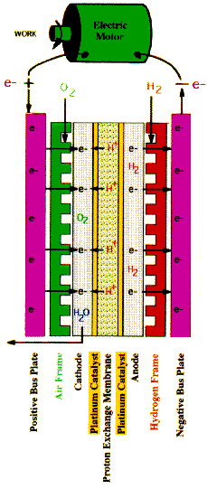
PROTON EXCHANGE MEMBRANE
At the anode the hydrogen molecules give up electrons and form hydrogen ions, a process which is made possible by the platinum catalyst.
The electrons travel to the cathode through an external circuit, producing electrical current. This current can perform useful work by powering any electrical device (such as an electric motor).
The proton exchange membrane allows protons to flow through, but stops electrons from passing through it. As a result, while the electrons flow through an external circuit, the hydrogen ions flow directly through the proton exchange membrane to the cathode, where they combine with oxygen molecules and the electrons to form water.
In this way, hydrogen fuel's natural tendency to oxidize and form water is utilized to produce electricity and useful work.
No pollution is produced and the only resulting products are water and heat.
The equations look like this:
Anode: 2H₂ --> 4H⁺ + 4e⁻
Cathode: 4e⁻ + 4H⁺ + O₂ --> 2H₂O
Overall: 2H₂ + O₂ --> 2H₂O
DME
Pulchowk Campus, IOE

Slide 51
INSPECTION AND MAINTENANCE PROGRAM
DME
Pulchowk Campus, IOE

Slide 52
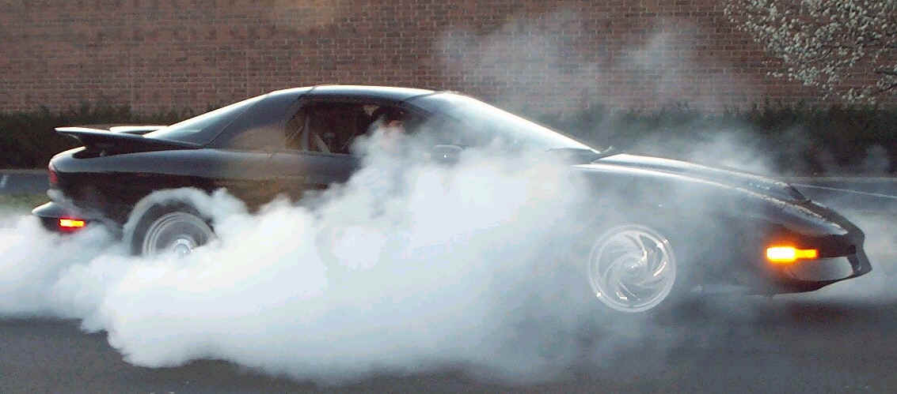
PURPOSES OF I/M PROGRAM
Prevent air pollution
Reduce fuel consumption
Secure safety
Identify gross polluters
DME
Pulchowk Campus, IOE
Notes:
To identify gross polluters (usually 20-25% of vehicles pollutes more than 50% of total vehicle emissions)
To prevent air pollution
To secure safety of passengers/vehicles
To reduce fuel consumption

Slide 53
APPLICATION OF THE I/M CREDIT
EMISSION
LEVEL
Before repair
Inspection effect
After repair
VEHICLE AGE
DME
Pulchowk Campus, IOE
Notes:
Pollution of high-emitting vehicles , if identified in time, can be reduced significantly after proper repair.
As already mentioned earlier a relatively small fraction of on-road vehicles are responsible for a relatively large fraction of emission. The I/M credits are applied to the fraction of the fleet that is identified and repaired from emission levels considered to be of high emitters status due to either malfunctioning of, or tampering with the emission-control system.

Slide 54
INSPECTION FREQUENCY
At present, commercial vehicles (high mileage vehicles) are
tested every six months and other types are tested annually.
Vehicle description | Vehicle age
 | < 3 years | 3 – 15 years | > 15 years
Motorcycle & scooters (gasoline) | Exempt | Annually | Annually
Car/jeep/van/pick-ups (gasoline) | Exempt | Annually | Annually
Commercial vehicles and diesel vehicles | Annually | Annually | Every 6 months
Government & corporation vehicles | Annually | Annually | Every 6 months
All other vehicles | Annually | Annually | Every 6 months
DME
Pulchowk Campus, IOE
Notes:
Proposed schedule for compulsory motor vehicle emission test.
At present, commercial vehicles (high mileage vehicles) are tested every six months and other types are tested annually.

Slide 55
INSPECTION AND MAINTENANCE
Enforce emission standards without waiver
No operation until repair
Road side testing
High penalties for high emitters
Regulate repair industry/workshops
Train mechanics
Regulate parts
DME
Pulchowk Campus, IOE

Slide 56
CAUSES OF EXCESSIVELY SMOKY VEHICLES
Excessive oil consumption
  The presence of engine oil in the combustion chamber. This can be a result of excessive amounts of oil passing the piston and ring assemblies and/or through leakage at the valve seals.
Faulty fuel system
  An incorrect air fuel mixture. This can be due to a faulty choke operation, blocked air filters and failure or improper adjustment of the carburettor or fuel injection equipment. These problems also cause excessive fuel consumption and loss of drivability.
Ignition problems
  Failure of the vehicle's ignition system to ignite the fuel charge will result in excessive emissions. Under these conditions the drivability of the vehicle will be seriously impaired.
Causes of excessive smoke from diesel engines
  Excessive smoke from diesel engines is usually the result of worn or poorly maintained fuel injectors or pumps, or an incorrectly set fuel pump or dirty air cleaner. The smoke is simply unburnt, wasted fuel. These problems can be rectified by adjusting the equipment to within manufacturers specifications and replacing worn parts.
DME
Pulchowk Campus, IOE

Slide 57
APROPRIATE VEHICLES
Import of vehicles with fuel injection system and catalytic converter. These vehicles are less polluting but demand lead free petrol.
Use of particulate traps in diesel-fueled vehicles and new imported vehicles should come with catalytic converter.
The vehicles running on alternative fuels are less polluting than petrol-fueled vehicles. Extension of existing service of trolleybus to along ring road and outer ring road (in long-term perspective).
Battery operated electric vehicles are much appropriate means of transport to the core city areas and historic places of Kathmandu Valley.
DME
Pulchowk Campus, IOE

Slide 58
CONCLUSIONS & RECOMMENDATIONS
Introduce a standard of carrying capacity against engine capacity for commercial vehicles.
Introduce the new emission standards for Euro-I , II, III in-use vehicles.
Computerize the registration of vehicles at BZTMO and emission testing of vehicles at DoTM and KVTPO.
Strengthen and improve the regulatory mechanism to control the pollutants emission level and de-register the vehicles, which do not meet the emission standards irrespective of age and category after failing 2 tests.
DME
Pulchowk Campus, IOE

Slide 59
CONCLUSIONS & RECOMMENDATIONS
Is it possible to eliminate smoky vehicles totally from the roads?
* Improve Engine
Technology
* Use of Cleaner Fuel
* Proper Vehicle
Maintenance
* Education
* Enforcement
* Certification of Motor
Workshops Scheme
* CDST
* Improve Engine technology
* Use of Cleaner Fuel
* Proper Vehicle Maintenance
DME
Pulchowk Campus, IOE

Slide 60
THANK YOU !
DME
Pulchowk Campus, IOE

